Slide 1
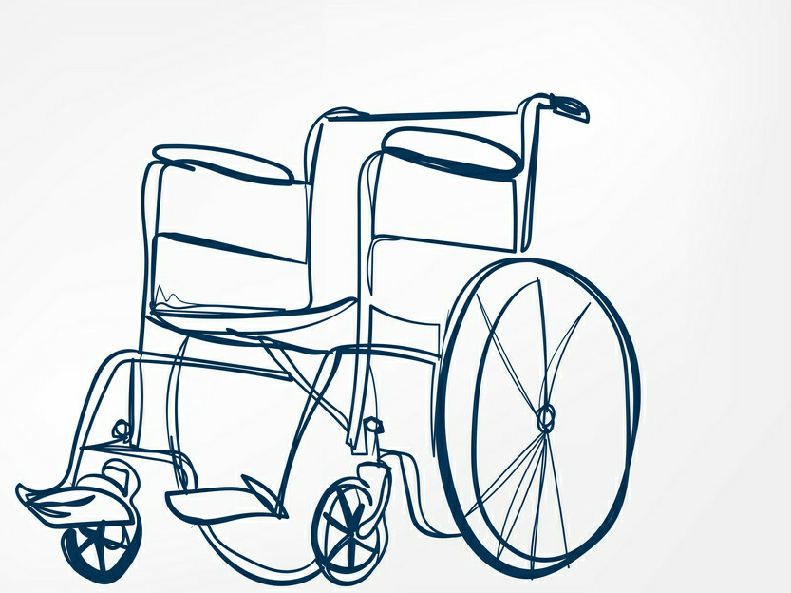
SMART WHEELCHAIR

Slide 2
ABSTRACT:
The wheelchairs available in market are too expensive and are beyond the reach of poor and middle class families. Most of the Wheelchairs are single functioned either it will be operated with voice or joystick. We are designing a wheelchair that will be a low cost and multifunction. This project aims to make life easier for the disabled and elderly people who cannot move properly it will enable them to lead better lives without any problem.

Slide 3
INTRODUCTION:
People who are suffering from disease like paralysis, polio or from some accident and loss their hands and legs need some artificial source with the help of which they can move. In order to minimize their problem we have developed a “smart wheelchair” which will operate on the voice commands from the handicapped user for movement purpose the voice commands of the handicapped will be first saved in the voice recognition module before using it so that other person from outside cannot give command to it. As additional features we are also using joystick and sensors so to provide more protection to the user. It will be helpful to handicapped persons due to different reasons. When handicapped is using simple wheel chair they face many problems which can cause many accidents. Mostly simple wheel chair is drive by the handicapped through has hands. We are designing such wheel chair that will provide extra safety features that prevent common wheelchair accidents. Because we are using voice commands, sensors and also joystick it will minimize the accidents. We are developing such a wheel chair that will be helpful for handicapped in hospitals or nursing home settings feel safer about their surroundings.

Slide 4
OBJECTIVE:
The objective of this project is to help physically challenged people.
It will basically very helpful for those who cannot able to walk.
Physically challenged people can use this android based wheel chair.
It uses android based Smartphone’s which have inbuilt axis accelerator sensors and Bluetooth wireless technology

Slide 5
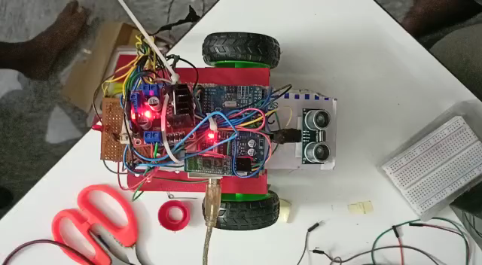
WORKING MODEL :
SMALL VIDEO OF OUR WORKING PROTOTYPE

Slide 6
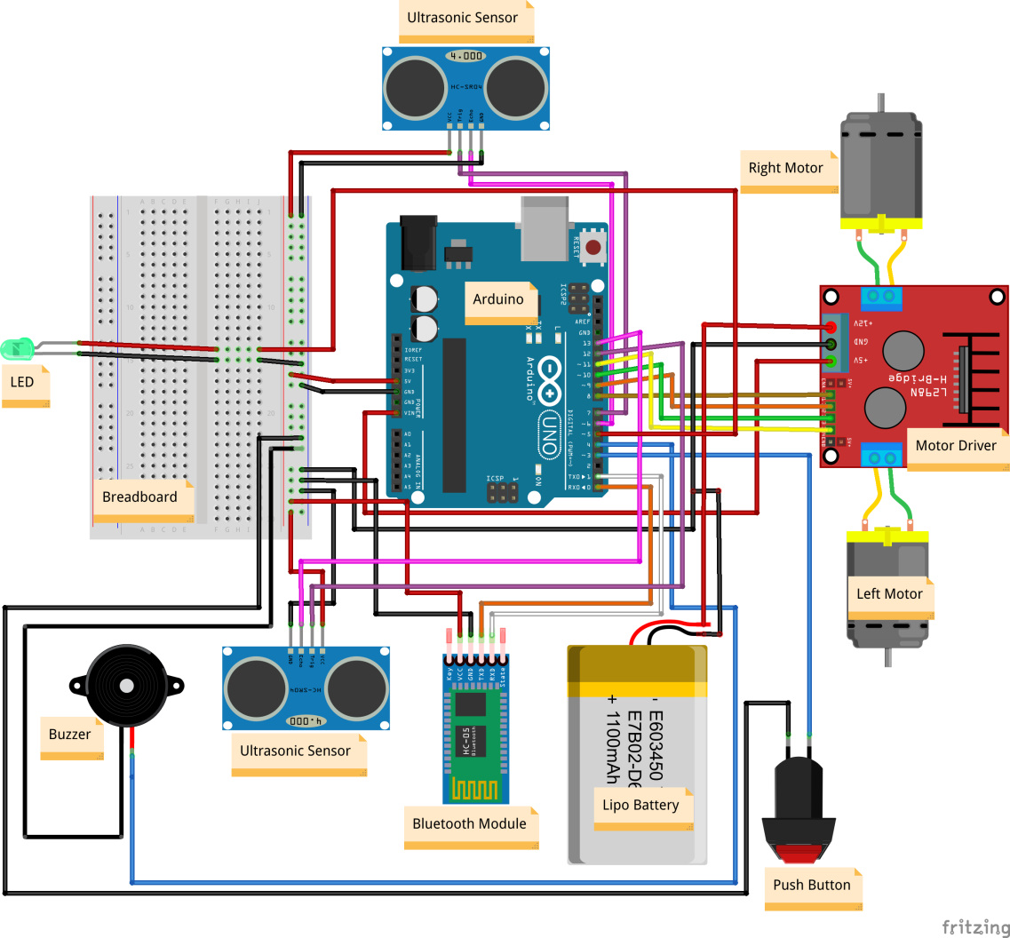
Circuit Diagram:

Slide 7
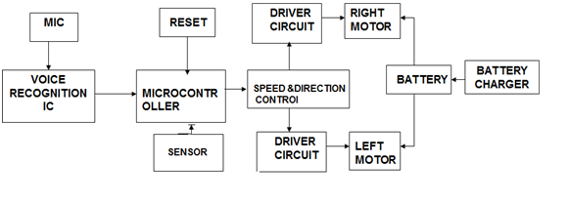
BLOCK DIAGRAM

Slide 8
SOFTWARE REQUIRED :
Arduino Voice control Application
Arduino IDE
HARDWARE REQUIRED :
Bluetooh module HC05
Arduino uno
Motor drive

Slide 9
ADVANTAGES :
• Obstacle detection using IR sensor.
• Less expensive.
User friendly.
• Collision free travel.
Reduce manpower.
Economical

Slide 10
APPLICATIONS :
Physically Challenged People :
Physically Disabled People can use it as per their purposes.
Patients in the Hospitals :
People suffering from certain paralysis can use either voice or head movement as per requirement
Old Age Homes :
People at old age homes can use this chair as per their requirement.

Slide 11
FUTURE SCOPE:
Improvements can be made by using various hand gestures of the user.
Eyes movement based automated wheel chair.
Battery can be recharged by the alternator.
Automatic balancing of sitting area can be provided using secondary accelerometer in case of bumps and curbs.
Navigating the actual position of wheel chair.

Slide 12
LITERATURE SURVEY
“Voice operated intelligent wheelchair” by Ms.S.D.Suryavanshi , Mr.J.S.Chitode Ms.S.S.Pethakar,”International Journal of advanced research in computer science and software engineering.
“Voice based direction and speed control of wheel chair for physically challenged by M.Prathyusha, K.S.Roy, Mahaboob Ali Shaik,” International journal of Engineering Trends and Technology(IJETT).
“A wheelchair steered through voice commands by Babriel Pires and Urbano Nunes” Journal of Intelligent and Robotic.
“Smart wheelchair: A Literture survey”, by Richard Simpson “Journal of Rehabilition Research & Development.

Slide 13
http://www.who.int/medicenecentre/news/notes/2013/disability_and_development_20130920/en
http://www.indiability.org/resources/disability- in-india
www.techtriks.wordpress.com
http://www.electroschematics.com/wp- content/uploads/2013/01/PIC16F877A- Datasheet.pdf

Slide 14
CONCLUSION:
The main aim of this project implementation is to help all the people who are dependent on wheelchair for their mobility.
Wheelchair is simple to operate and does not need any external help.
The objectives of this project have been achieved successfully.
This project was able to develop an android system that can control the movement of the wheelchair.
The application built can be used with android phones.

Slide 15
THANK YOU

Slide 16
TEAM MEMBERS : Gowtham raj . E nivvetan . P jagadesh . A dikshitha . S harshini . r

